Slide 1
COMP 430
Lab 5 – Sensors

Slide 2
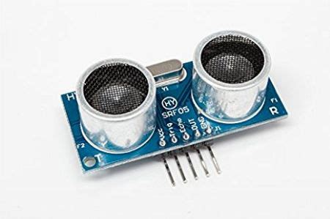
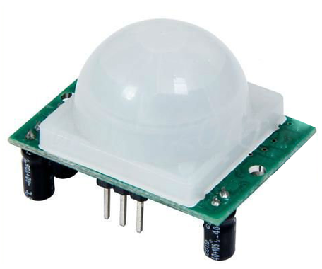
Ultrasonic and heat

Slide 3
Batfink’s supersonic sonar radar

Slide 4
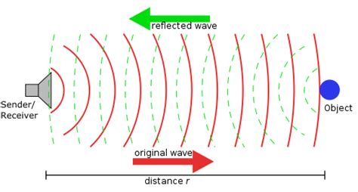
Ultrasonic operation

Slide 5
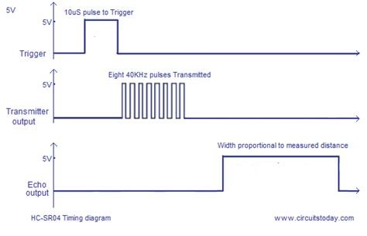
The Pi’s POV

Slide 6
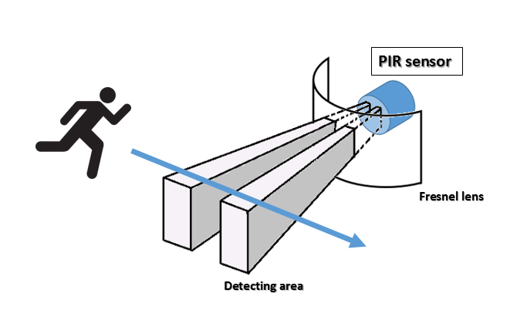
PIR operation

Slide 7
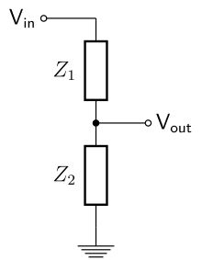
Converting 5V to 3.3V
5V signal from Echo output
1K ohm resistor
3.3V to the Pi
2K ohm resistor

Slide 8
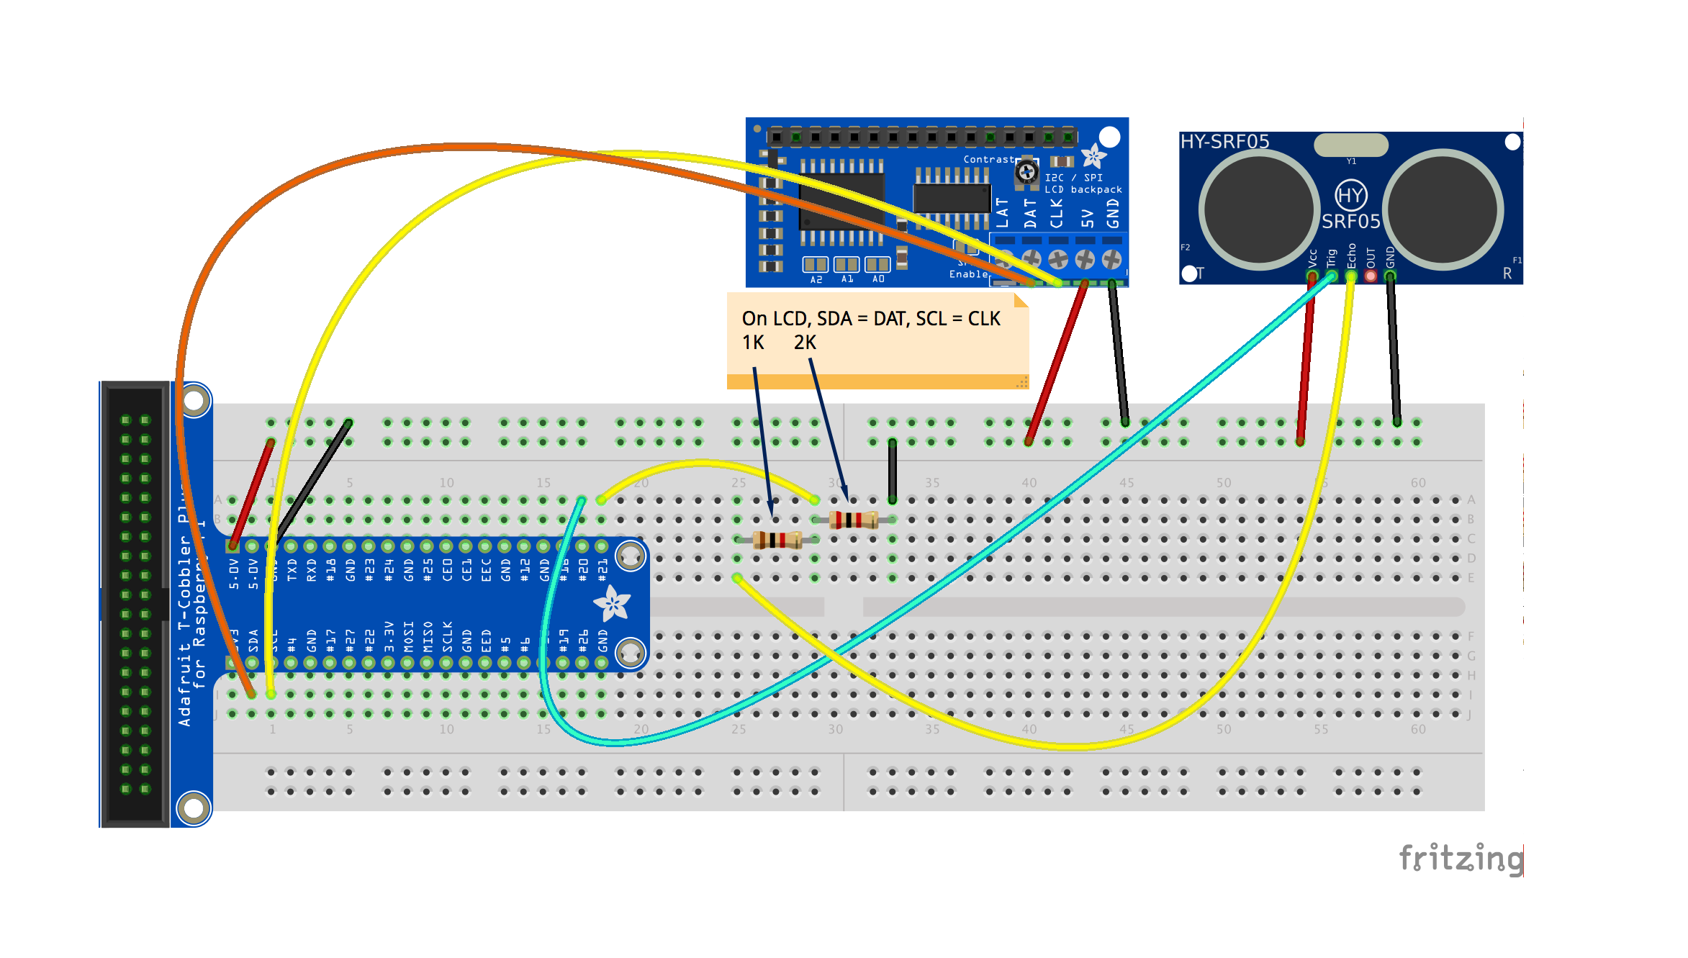
LCD connected via I2C

Slide 9
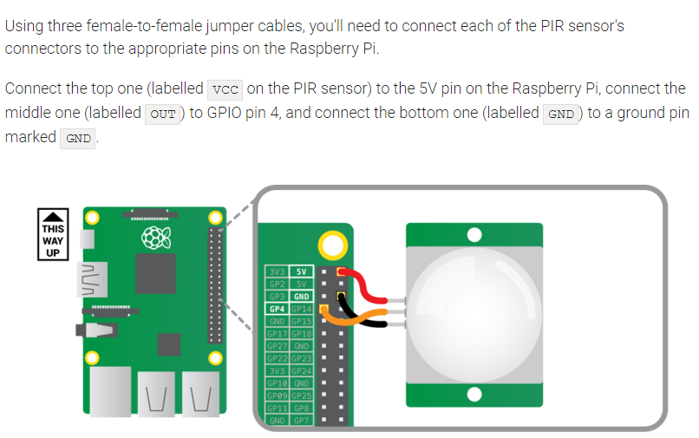
The PIR looks like a pushbutton

Slide 10
Safety Engineer
As the newest engineer at Absturz Motors, your task is to use sensors to design a system to prevent a self-driving car from crashing. When it senses the car is coming too close to something it hits the brakes. Remember that the speed matters too – you can come close to an object if you’re going slowly and you have to brake sooner if you’re moving quickly.
V = ∆D / ∆T and A = ∆V / ∆T
Use LEDs and your display to let the driver know what’s happening. Use a red LED to represent the brakes.

